Slide 1
Cara-Webinar
Tools
Kees Dekker
Reader (assoc. prof.) in Older English Language and Culture
University of Groningen
The Netherlands
Teaching: Old English, Middle English, History of the English Language, English as a Second Language
Research: Old English and Anglo-Latin encyclopaedic manuscripts and texts
the study of Old English and Old Germanic languages in the early modern period

Slide 2
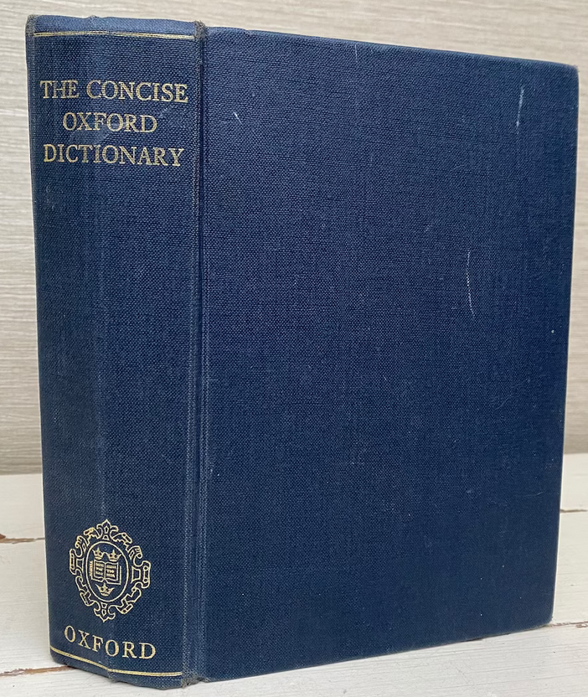
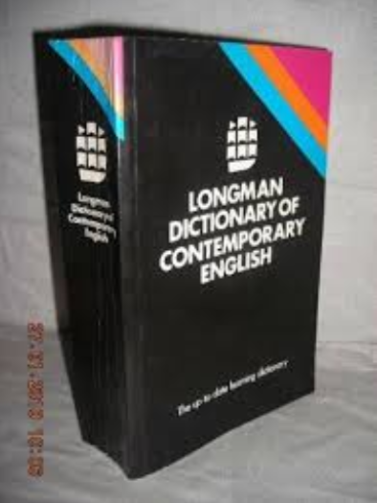
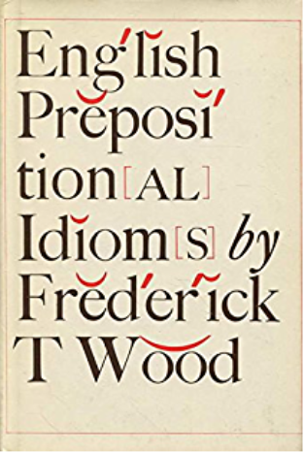
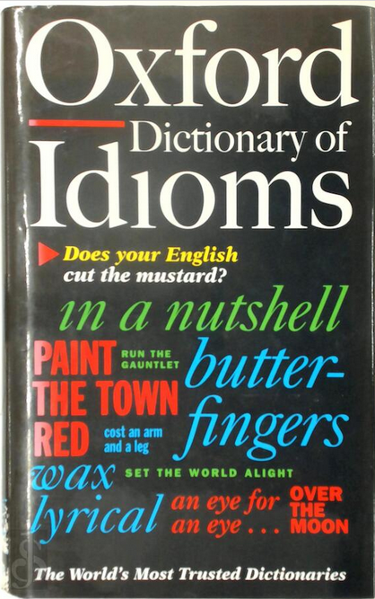
Background
I was taught exclusively in the Netherlands (in the pre-internet era).
Composition was not a very prominent subject.
The only tools available to us were dictionaries. I had two: the Longman’s dictionary and the ‘Oxford’ dictionary.
I was forced to learn books of vocabulary by heart.
We learnt meanings, forms and pronunciation.
Idioms:

Slide 3
Questions
How do words combine with each other?
Does one have an awesome interest or a serious interest; a flaming interest or a burning interest.
Does one concur to an opinion, or with an opinion? Can the verb to concur be used without a preposition?
Does one draw an observation or make an observation?
How do words alternate with each other?
For example, in the sentence The positive effects of the medication were shown by the patients’ recovery, which showed the need for its mass production.
What can we do to vary our prose without affecting our texts negatively. And how can we do it relatively fast?
Which kinds of tools can help us deal with our questions and uncertainties when we edit our own scholarly text?
We will have a look at three types.

Slide 4
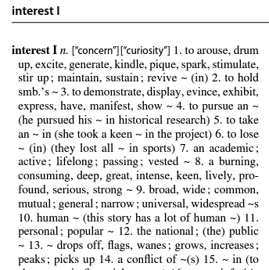
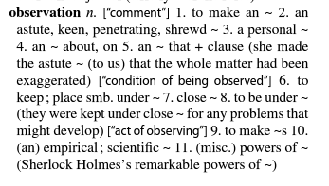
Dictionaries of word combinations a.k.a. collocations dictionaries
Informative and efficient
Excellent for self-editing
Freely available online: https://www.macmillandictionary.com/collocations/about.html
https://www.freecollocation.com/
https://ozdic.com/

Slide 5
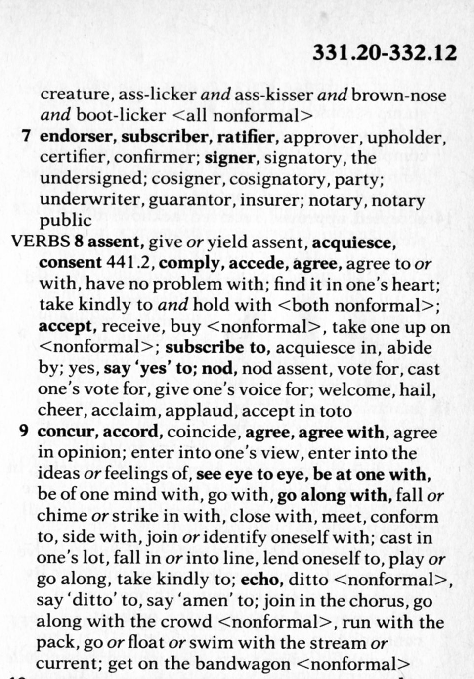
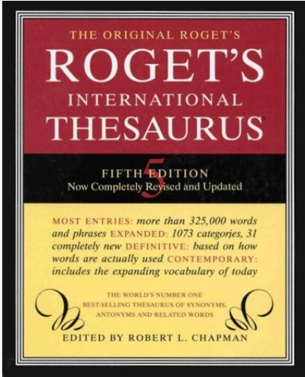
A Thesaurus (words and word combinations arranged by meaning)
Words and word combinations arranged by categories of meaning (semantically), for example: Roget’s category 332 comprises all words falling under the concept ‘to assent
Thesauri often provide options that you hadn’t thought of, or which had escaped your mind
Not all thesauri provide contextualised examples; Roget’s, for example, provides only lists
The Oxford English Dictionary has a thesaurus function, but its usage is complicated, and the package is expensive.
But see
https://www.collinsdictionary.com/dictionary/english-thesaurus/concur

Slide 6
Phrase banks
Provide examples of phraseological nuts and bolts
Are sometimes part of larger online writing resources
Phrasebanks and related software may make use of AI (artificial intelligence)
I will illustrate the use of two phrasebanks which are (in part) freely available online
TRINKA is an app and browser plug in offering all kinds writing tools
https://www.trinka.ai/academic-phrasebank-browse
Manchester Academic Phrasebank (freely available from the University of Manchester), available online and in PDF or Kindle format.
https://www.phrasebank.manchester.ac.uk/

